Slide 1
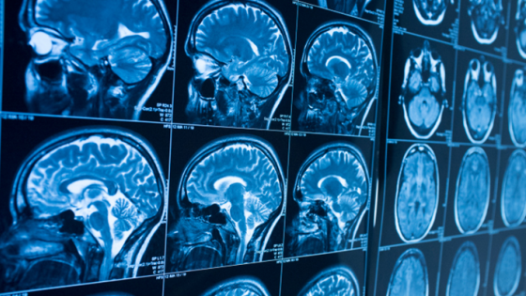
A GREAT AND IMPORTANT CHALLeNGE: THE SYNTHESIS OF THE MEDICAL IMAGE
Andrea Bellia 1586420
Alessia Carotenuto 1764400
Veronica Romano 1580844

Slide 2
Abstract
Our work is based on an article by Dong Nie et al. entitled "Medical Image Synthesis with Deep Convolutional Adversarial Networks" which deals with the use of a Generative Adversarial Network (GAN) for the synthesis of medical images from MRI. In particular, the above-mentioned network was trained using the BraTS'20 dataset, i.e. Multimodal Brain Tumor Segmentation Challenge 2020. Specifically, we used T1ce (Contrast Enhanced) and T2 images to perform T2 image synthesis from T1ce images.
15/09/2020 - neural networks project

Slide 3
SUMMARY
Introduction to medical imaging and work purposes
Dataset choice and its principles
Network architecture
Supervised deep convolutional adversarial network
Loss functions
Auto-Context Model for refinement
Experiments and results
Final comparisons
15/09/2020 - neural networks project

Slide 4
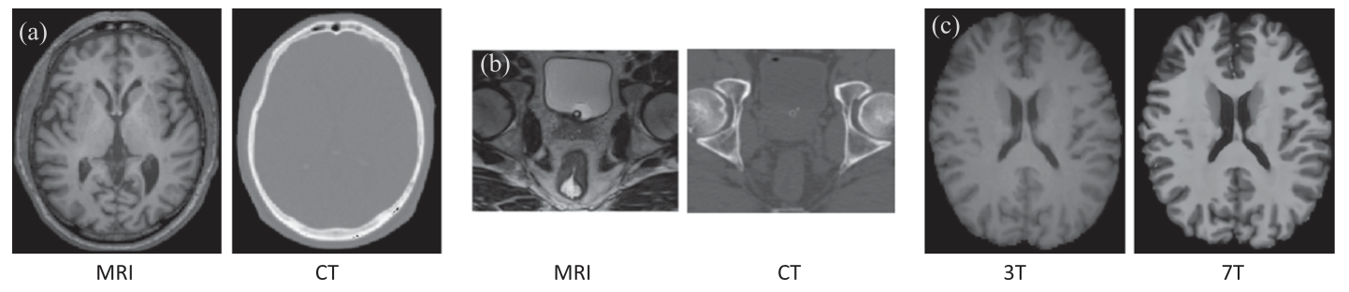
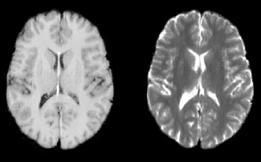
Introduction to medical imaging and work purposes
T1ce
T2
15/09/2020 - neural networks project

Slide 5

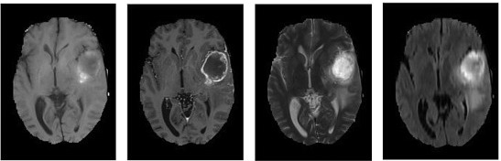

Dataset choice and its principles
T1
T1ce
T2
FLAIR
15/09/2020 - neural networks project

Slide 6
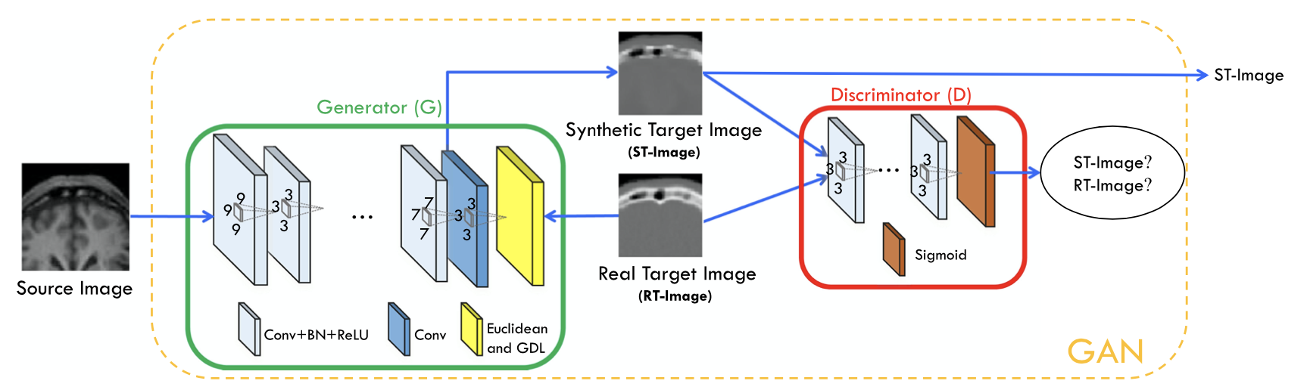
Network architecture
15/09/2020 - neural networks project

Slide 7
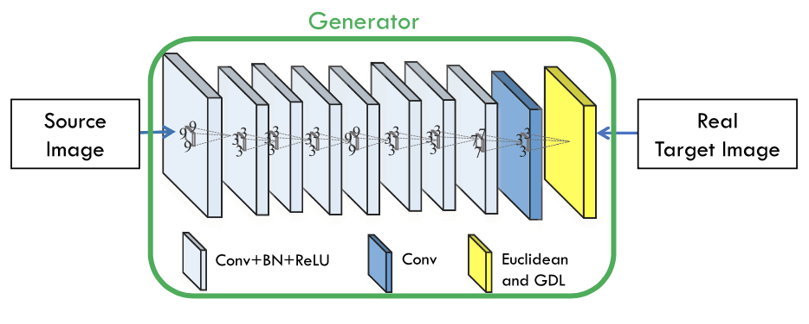
SUPERVISED DEEP CONVOLUTIONAL ADVERSARIAL NETWORK
15/09/2020 - neural networks project

Slide 8
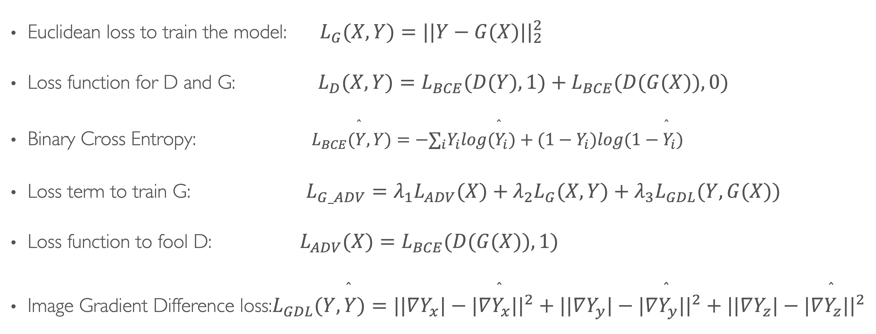
LOSS FUNCTIONS
Euclidean loss to train the model: $L_{G}(X,Y)=||Y−G(X)||_{2}^{2}$
Loss function for D and G: $L_{D}(X,Y)=L_{BCE}(D(Y),1)+L_{BCE}(D(G(X)),0)$
Binary Cross Entropy: $L_{BCE}(\overset{̂}{Y},Y)=−∑_{i}Y_{i}log({\overset{̂}{Y}}_{i})+(1−Y_{i})log(1−{\overset{̂}{Y}}_{i})$
Loss term to train G: $L_{G_ADV}=λ_{1}L_{ADV}(X)+λ_{2}L_{G}(X,Y)+λ_{3}L_{GDL}(Y,G(X))$
Loss function to fool D: $L_{ADV}(X)=L_{BCE}(D(G(X)),1)$
Image Gradient Difference loss:$L_{GDL}(Y,\overset{̂}{Y})=||∇Y_{x}|−|∇\overset{̂}{Y_{x}}||^{2}+||∇Y_{y}|−|∇\overset{̂}{Y_{y}}||^{2}+||∇Y_{z}|−|∇\overset{̂}{Y_{z}}||^{2}$
15/09/2020 - neural networks project

Slide 9
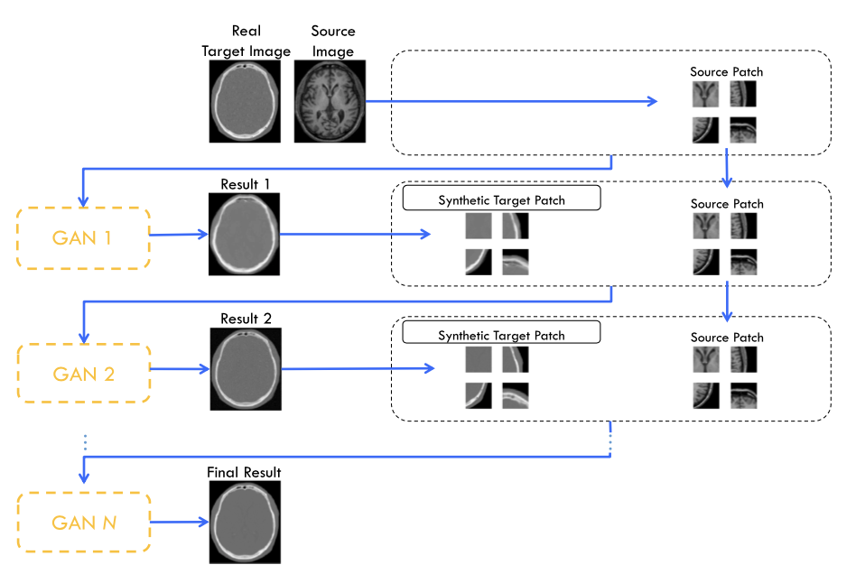
AUTO-CONTEXT MODEL FOR REFINMENT
15/09/2020 - neural networks project

Slide 10
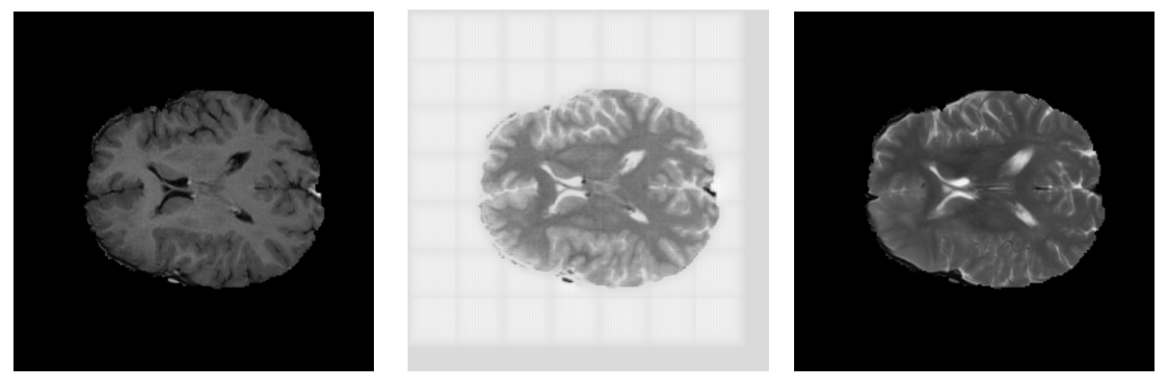
Experiments and results
T1ce
T2 predicted
T2 ground-truth
15/09/2020 - neural networks project

Slide 11
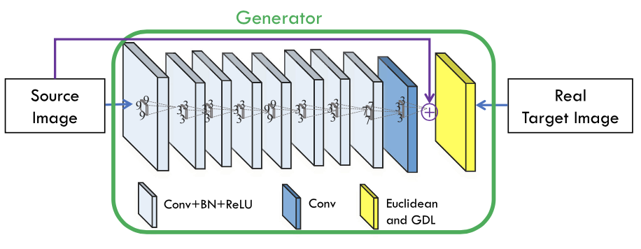
Final comparisons
Different datasets
Different tasks
No use of residual learning
15/09/2020 - neural networks project

